Slide 1
An Ageing Society Patrick Bonnett

Slide 2
Ageing and rurality is well recognised
“One of the most significant changes rural communities consistently raised with me was the impact of demographic change.”

Slide 3
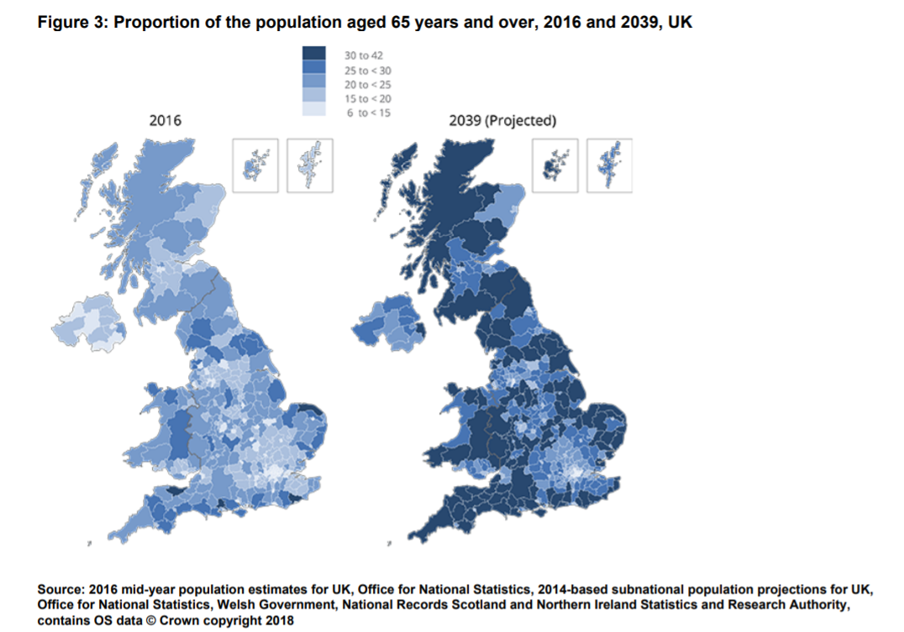
Why does it matter?

Slide 4
Scottish Islands
Western Isles aged dependency ratio (over 65/16-64 working age will reach 61% in 2033
By 2033 Western Isles ADR will be 21% higher than Scotland as a whole
Position even worse for outer Islands (not the ‘mainland’) where ASR is already 60% and forecast to hit 90% by 2033
Source: National Registers of Scotland 2016 population projections

Slide 5
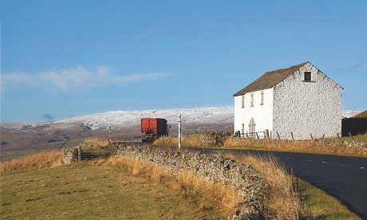
Shocking report reveals sad & lonely lives of dale's isolated older people The sad and lonely lives being led by many old people in Teesdale have been revealed in a worrying report. Newcastle University says that despite the vital help offered by local groups – such as Teesdale Day Clubs, Teesdale Disability Access & the churches – many elderly people living in the dale are suffering from social isolation and loneliness.

Slide 6
The Ageing Society Grand Challenge Pillars
Health & Care
Homes Families & Communities
Work, Learning & Purpose
Finance & Economy

Slide 7
Healthy Ageing Challenge Fund Framework
Seven themes which offer the greatest opportunities to tackle market failures and stimulate innovation:
Sustaining physical activity
Maintaining health at work
Designing for age-friendly homes
Managing common complaints of ageing
Living well with cognitive impairment
Supporting social connections
Creating healthy and active place

Slide 8
Other considerations
What are the opportunities at the intersections of the Grand Challenges?
How do we get the best possible design so that products and services are things of aspiration, not desperation?
How do we place the end user at the heart of the solutions to identify what’s needed and co-create the right solutions?
What does a demonstrator for rural areas look like?
What are appropriate success metrics?
How do we ensure interventions and solutions are meaningful and visible

Slide 9
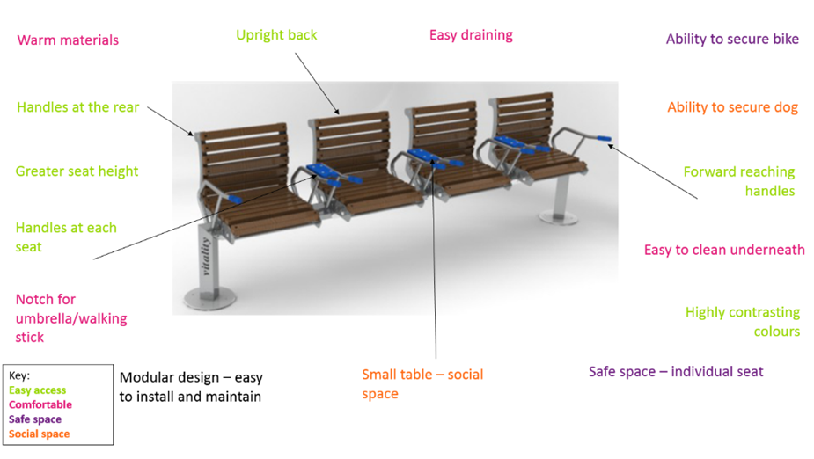
Meaningful & visible

Slide 10
An international challenge and opportunity
“Ageing population a challenge for New Zealand”
“Canada is unprepared for the demographic time-bomb hurtling at us”
“Spain is expected to become the world’s second oldest country by 2050”
“Fewer births, more deaths as Singapore population ages”
“Time for action on Australia’s ageing population”
“PM states desire for more collaboration between UK and Nordic and Baltic experts on ageing”

